Slide 1


TREK Travel App
Alejandro Amaya Giron, Churong Zhang, Xizhen Yang,
Kaitian Li, Jisoo Kim, Kent G, Frank Cazarez

Slide 2

Cost Estimation
Architectural Patterns
Objectives
Diagrams
Motivation
Project Requirements
Project Timeline
FP Method
Hardware Cost
Software Cost
Personnel Cost
- Use Case Diagram
- Sequence Diagram
- Class Diagram
Model-View-Controller Pattern

Slide 3
Motivation
Many of us have relatives that encounter issues when they come to visit us, but due to the unfamiliar systems that we have in place in the United States. One of the many issues foreigners encounter while visiting the United States is our taxing system, because in most our relative’s countries the tax is already included in the sale price unlike our added federal tax and varied state taxes which we seek to solve in our software system. This software system we are seeking to develop would solve many of the issues our family members encounter not only in our strange financial system but to also look deeper to all of the other necessities they might have while visiting us. Furthermore, our goal is exceeded the essential needs of foreigners visiting the United States, and to give them additional functionalities such as a scheduler and tip calculator to make their stay an enjoyable one.

Slide 4
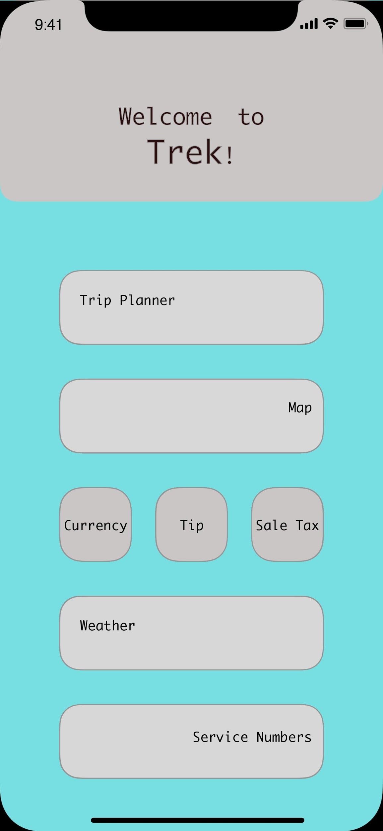
Objectives
Scheduler that helps to make trip plans.
Digital map that calculates the time if the user wants to visit multiple areas.
Currency Exchanger
Friendly suggestions on how much tip the user should pay based on what they purchase.
Calculate the sale tax based on what state you are located.
Weather information based on GPS location.
Locate and dial closest emergency service numbers, based on GPS location.

Slide 5
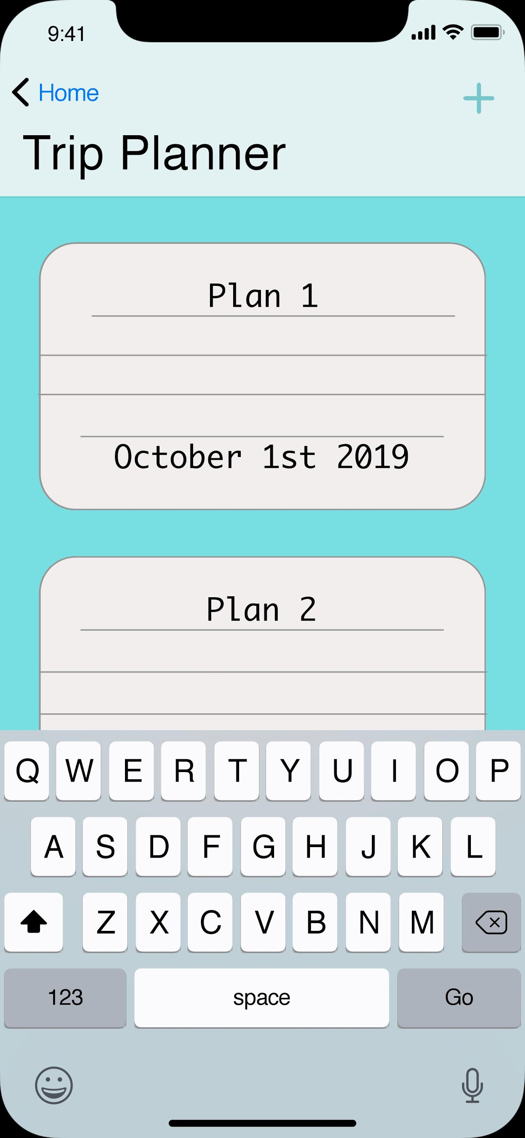
Feature #1: Trip Planner

Slide 6
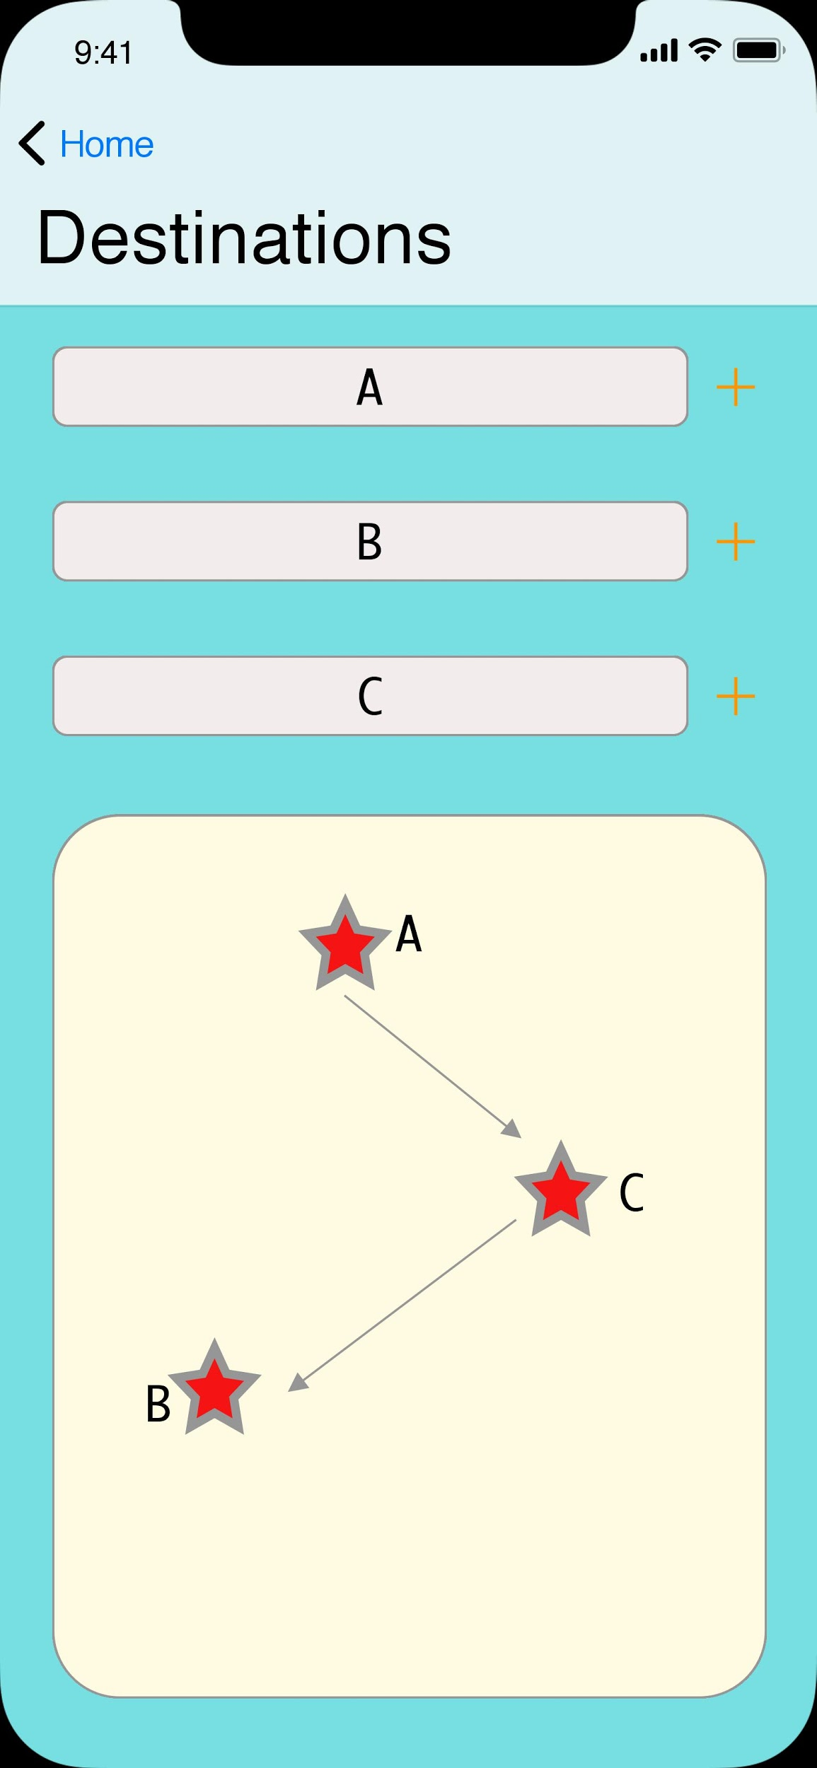
Feature #2 Map

Slide 7
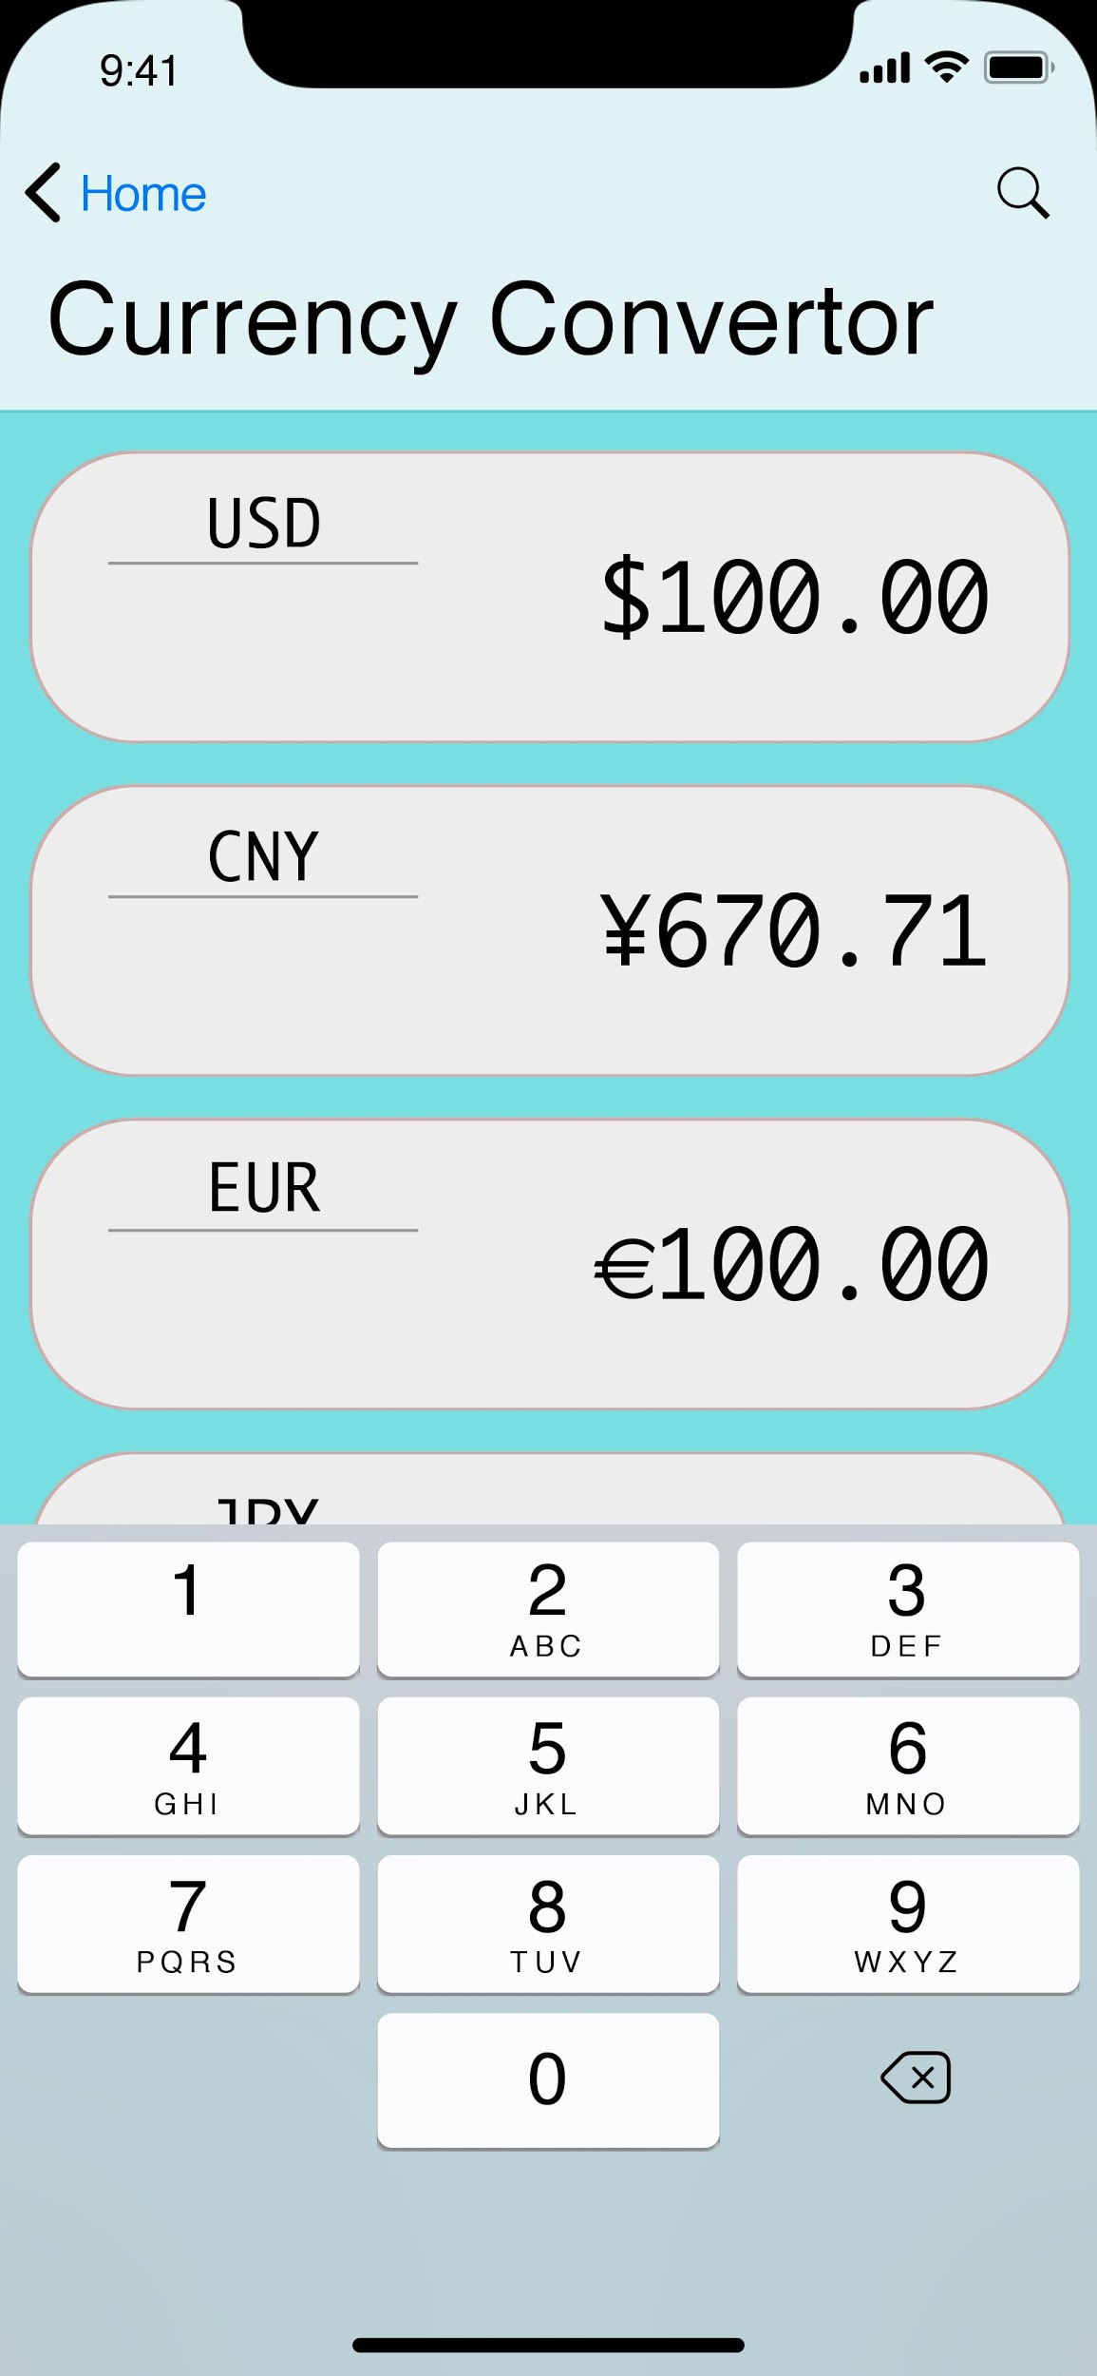
Feature #3 Currency Exchange

Slide 8
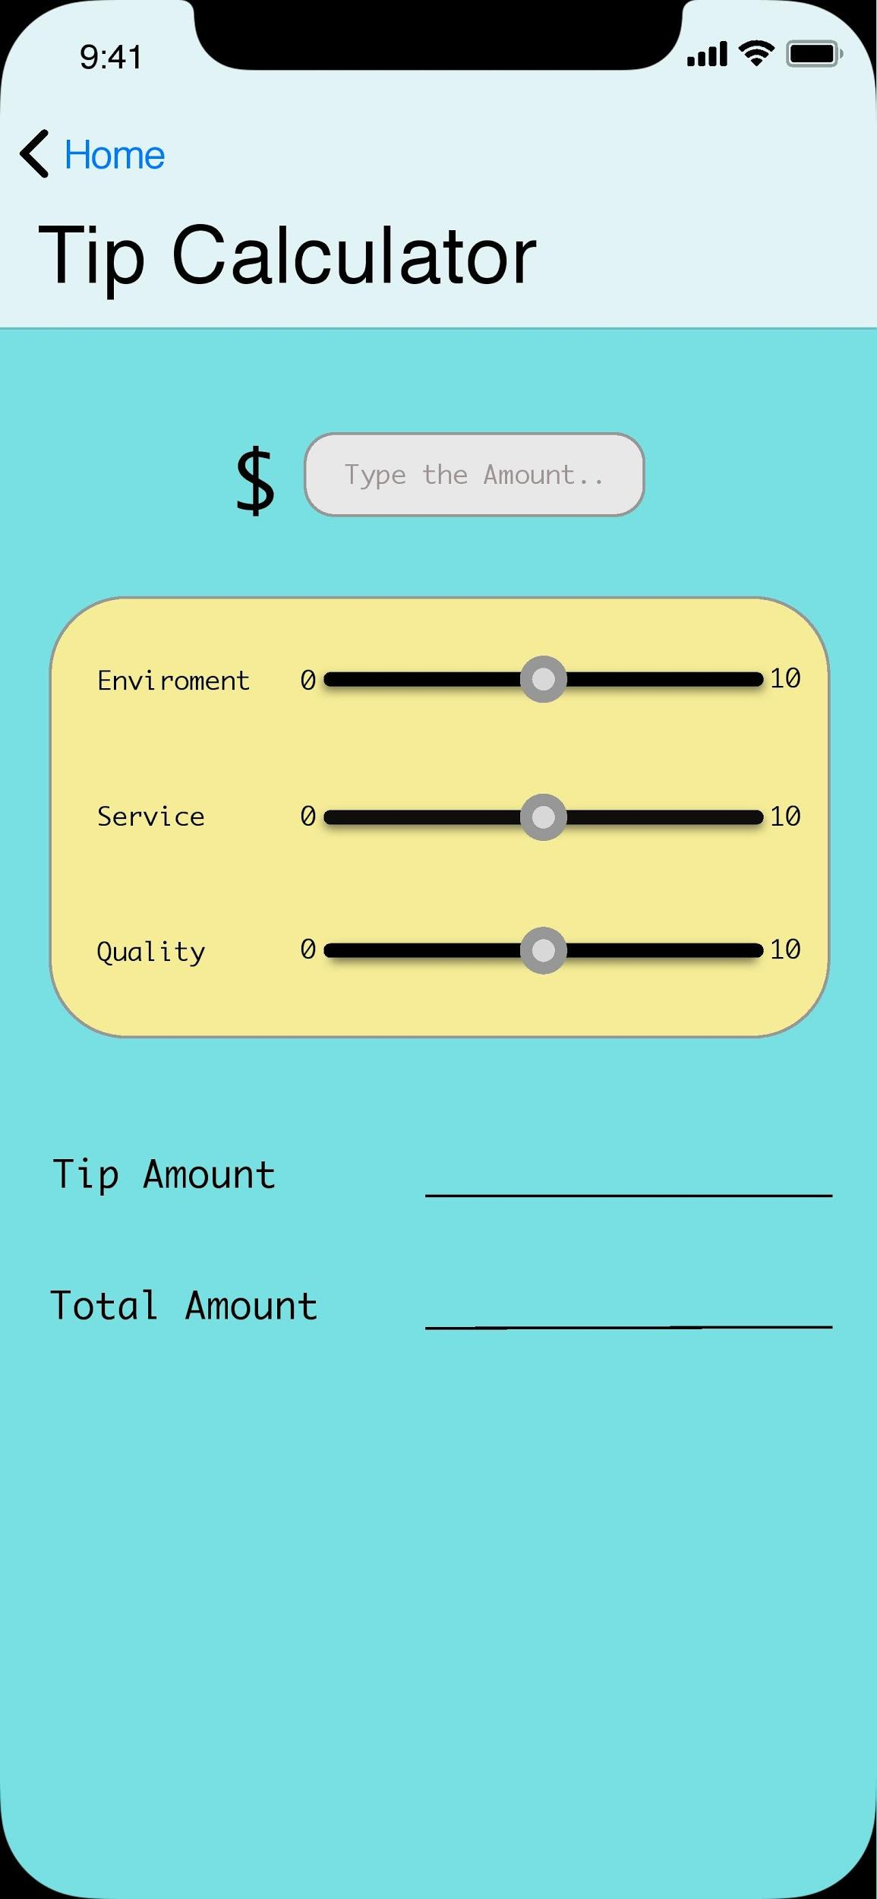
Feature #4: Tip Estimate

Slide 9
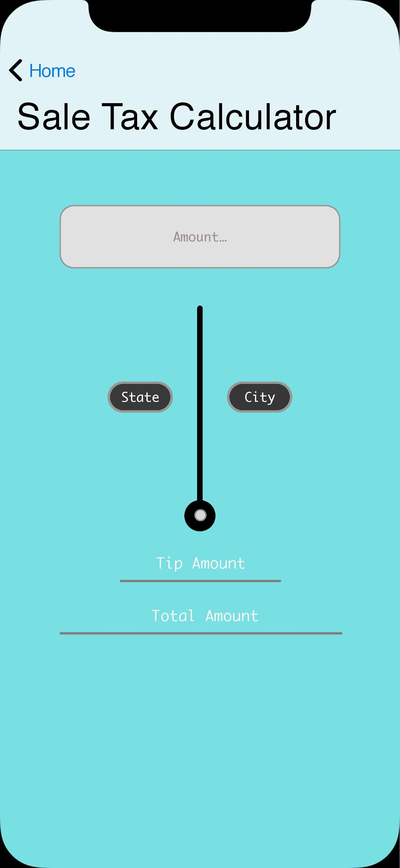
Feature #5: Tax Calculator

Slide 10
Feature #6: Weather
Feature #7 Local Services Numbers

Slide 11
Project Requirements
Functional Requirements:
Currency converter
Calculate the sale tax based on the city
Tips suggestions on various services based on user’s preference
Local weather information
Distance and time calculator if you want to visit certain locations
Scheduler that will pull up recommendations within certain parameters of the area you are located and plan the path of travel for user
Locate and dial closest emergency services based on GPS location
Non-functional Requirements:
Currency converter should support up to 166 different currencies, and must be real time exchange rate
Provide sales tax information for at least more than 100 cities in United States
Tip suggestion should be simple to use
The distance and arrival time calculation should take the traffic and other automotive incidents into consideration
Local weather should have current weather, and up to 5 days advance
Scheduler should save user activity and travel log permanently
Emergency services should be easy to access and should be located easily within the app

Slide 12
Project Timeline
Task | Effort(person-days) | Duration(days) | Dependencies
A: Requirement gathering | 2 | 2
B: Tasks analysis | 1 | 1 | A
C: Feasibility study | 2 | 2 | A
D: purchase hardwares and set room | 4 | 2 | B,C
E: User Interface design | 10 | 5 | B,C
F: User Interface design implementation | 6 | 3 | D, E
G: Feature Implementation | 4 | 2 | D,E
H: Define users | 2 | 2 | D,E
I: Test and Debug | 8 | 8 | F,G

Slide 13
Cost Estimation -
FP Method
Functions
A. Currency Converter
B. Sale Tax Calculator
C. Tip Estimator
D. Map
E. Weather
F. Trip Planner
G. Local Service Number
Determine Complexity
 | Function Category | Count | Complexity | Count * Complexity
1 | Number of user input | 11 | 4 | 44
2 | Number of user output | 9 | 4 | 36
3 | Number of user queries | 9 | 6 | 54
4 | Number of data files and relational tables | 6 | 15 | 90
5 | Number of external interfaces | 9 | 10 | 90
Notes:
Determine function category count:
Total count 44
1. Number of user input:
Counts: 11
· Function A:
o Amount needed to be converted
· Function B:
o Amount needed to be calculated
· Function C:
o Original amount
· Function D:
o Destinations (max 5)
· Function E:
o N/A
· Function F:
o Title
o Time
o Place
· Function G:
o N/A
2. Number of user output:
Counts: 9
· Function A:
o Converted amount
· Function B:
o Calculated amount
· Function C:
o Suggested tip
o Total amount
· Function D:
o Suggested route
o Time
· Function E:
o Temperature
· Function F:
o Reminder
· Function G:
o Service number
3. Number of user queries:
Counts: 9
· Function A:
o Select “from” currency
o Select “to” currency
· Function B:
o Select city
· Function C:
o 3 service survey questions
· Function D:
o Selection of by car/walk
· Function E:
o N/A
· Function F:
o Alert option
· Function G:
o Select Service
4. Number of data files and relational tables
Counts: 6
· Function A:
o Real-time currency API
· Function B:
o Sale tax API
· Function C:
o Tip calculation API
· Function D:
o Google Map API
· Function E:
o Weather API
· Function F:
o Local data files
· Function G:
o Google Map API
5. Number of external interfaces
Counts: 9
· Function A:
o General UI page
o Currency selection UI page
· Function B:
o General UI page
· Function C
o General UI page
· Function D
o Map UI page
· Function E
o Weather page
· Function F
o Table view
o Detailed view
· Function G
o Service number table view

Slide 14
FP Method
Compute gross function point:
GPF = 44 + 36 + 54 + 90 + 90 = 317
Compute processing complexity adjustment (CPA):
PCA = 0.65 + 0.01 * (PC1 + … + PC14) = 1.1
Compute function point (FP):
FP = GFP * PCA = 317 * 1.1 = 348.7 FP
Estimated effort:
E = FP / productivity = 348.7 / 40 = 8.7175 ~= 9 person-weeks
Project duration:
D = E / team size = 9 / 8 ~= 2 weeks
Notes:
Determine processing complexity (PC):
1. Does the system require reliable backup and recovery?
2 - moderate
2. Are data communications required?
5 - essential
3. Are there distributed processing functions?
2 - moderate
4. Is performance critical?
4 - significant
5. Will the system run in an existing, heavily utilized operational environment?
5 - essential
6. Does the system require online data entry?
5 - essential
7. Does the online data entry require the input transaction to be built over multiple screens or operations?
3 - average
8. Are the master files updated online?
2 - moderate
9. Are the inputs, outputs, files, or inquiries complex?
2 - moderate
10. Is the internal processing complex?
1 - incidental
11. Is the code designed to be reusable?
4 - significant
12. Are conversion and installation included in the design?
1 - incidental
13. Is the system designed for multiple installations in different organizations?
4 - significant
14. Is the application designed to facilitate change and ease of use by the user?
5 - essential

Slide 15
Hardware Cost
Computer System Requirement:
Windows (XP or later), Linux, or Mac OS
3 GB RAM minimum, 8GB RAM recommended
2 GB disk space (500 MB for IDE, 1.5 GB for Android SDK)
IDE
Eclipse or Android Studio
Android SDK, Java
Mac or Android mobile
Assume programmers have computer for the whole project. Thus, the hardware cost is $0.

Slide 16
Software Cost
1. Currency API
a. Professional Plan
b. $39.99 per month
c. 100,000 Requests per month
d. 10-minute Updates
e. Historical Rates
f. Unlimited Support
g. HTTPS EncryptionC
h. Source Currency Switching
i. Currency Conversion
j. Time-Frame Queries
k. https://currencylayer.com/product
2. Sale Tax API
a. Premium Plan
b. $29 per month
c. 100,000 requests per month
d. http://zip-tax.com/pricing
Estimated Total: $610 per month to keep all services online.
3. Tips Data Table
a. Free
4. Google Map API
a. $0.50 per request
b. estimate $500 per month
c. https://cloud.google.com/maps-platform/pricing/
5. Weather API
a. Startup Plan
b. $40 per month
c. 5 days/3 hour forecast API
d. 16 days/daily forecast API
e. Weather maps 1.0
f. Weather alerts
g. https://openweathermap.org/price
6. Trip Planner
a. Free local data from user’s device
7. Local Services API
a. Use the same data from google Map API

Slide 17
Cost Estimation - Personnel Cost
Resource Name | Cost | Baseline Cost | Variance | Actual Cost | Remaining
Project manager | $5,760.00 | $0.00 | $5,760.00 | $0.00 | $5,760.00
UI designer 1 | $1,120.00 | $0.00 | $1,120.00 | $0.00 | $1,120.00
UI designer 2 | $1,120.00 | $0.00 | $1,120.00 | $0.00 | $1,120.00
Front-end engineer 1 | $2,520.00 | $0.00 | $2,520.00 | $0.00 | $2,520.00
Front-end engineer 2 | $2,520.00 | $0.00 | $2,520.00 | $0.00 | $2,520.00
Back-end engineer 1 | $2,880.00 | $0.00 | $2,880.00 | $0.00 | $2,880.00
Back-end engineer 2 | $2,880.00 | $0.00 | $2,880.00 | $0.00 | $2,880.00
Test engineer | $800.00 | $0.00 | $800.00 | $0.00 | $800.00

Slide 18
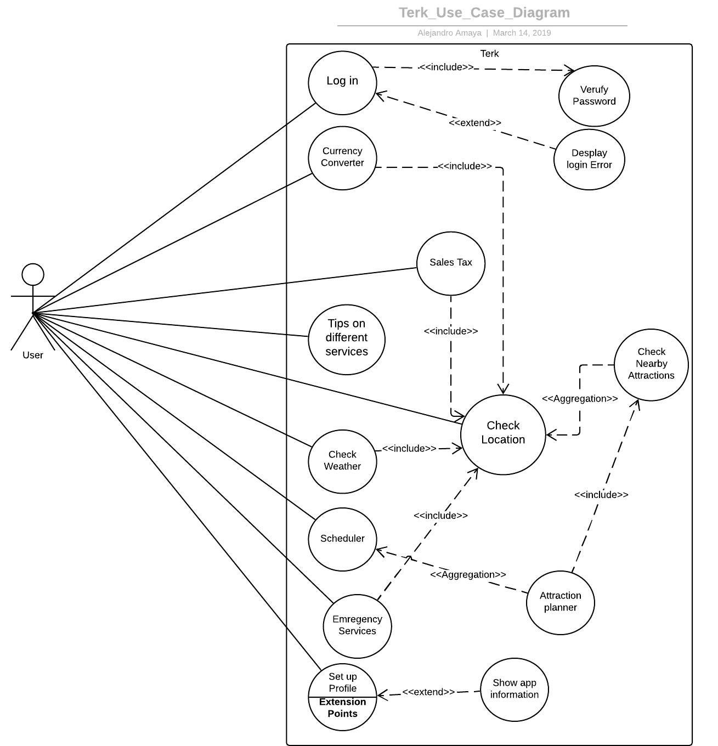
Use Case Diagram

Slide 19
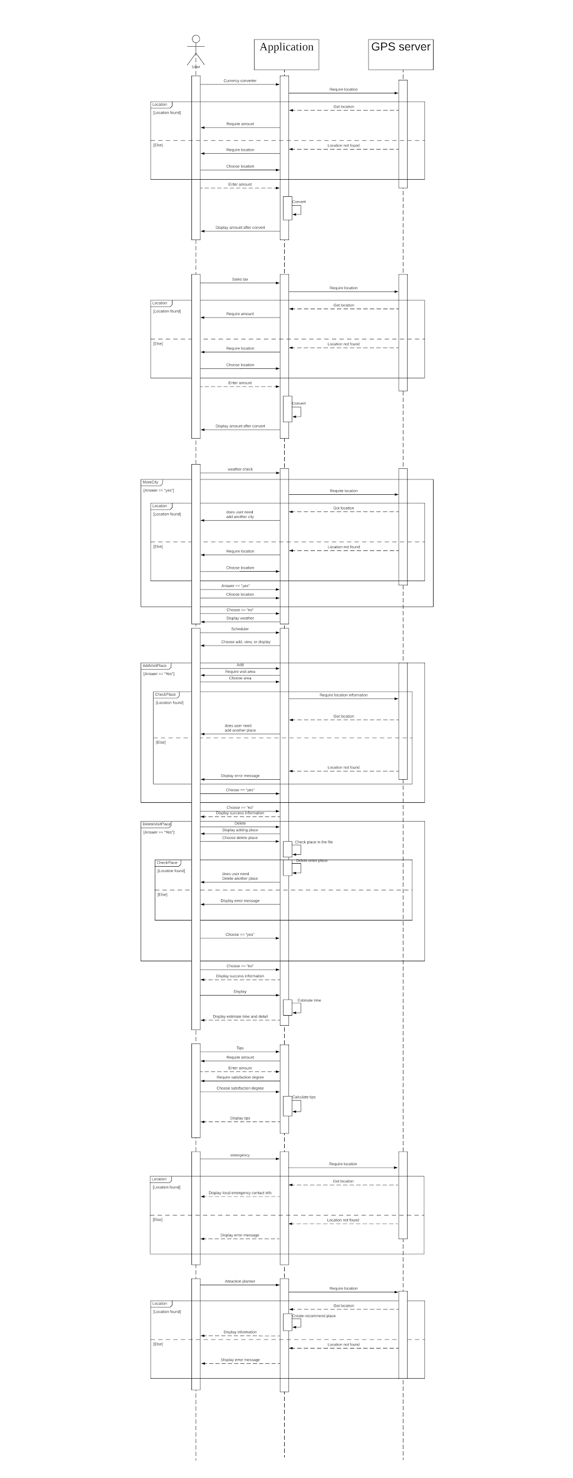
Sequence Diagram

Slide 20
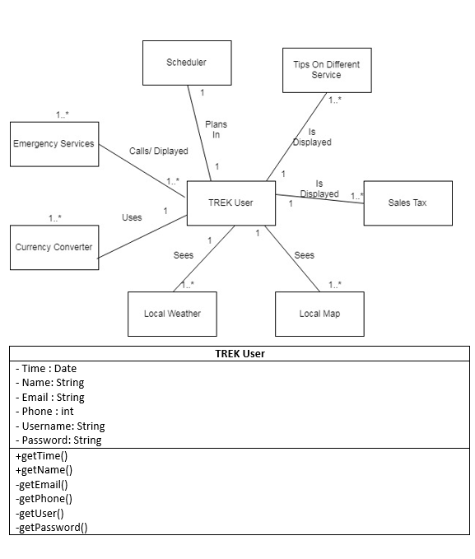
Class Diagram
Part 1 of 3

Slide 21
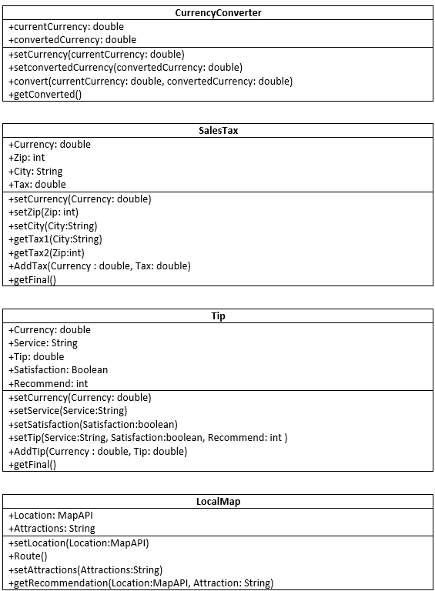
Class Diagram
Part 2 of 3

Slide 22
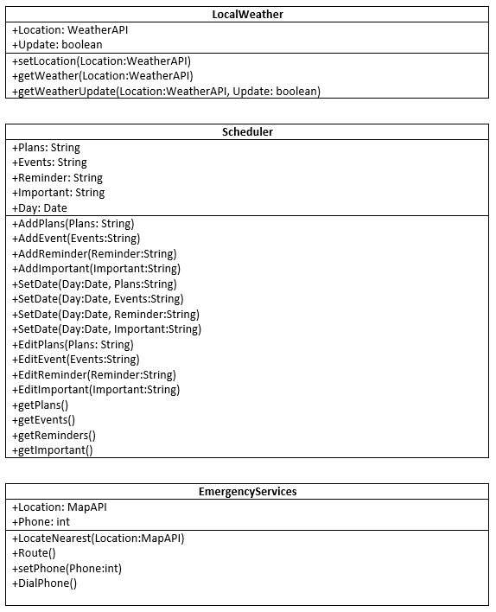
Class Diagram
Part 3 of 3

Slide 23
Model-View-Controller (MVC) Pattern
Model
Model component is in charge of the back-end support of our application. It will contain all the functions that allows multiple operations and various classes and models.
View
View component is in charge of the user interface, specifically what the user sees visually on the app. It will present the data and other extensive travel information to the user; It contains the code and the design for the interface.
Controller
Controller component manages the interaction of the application. It generates what to operate based on users’ action and returns appropriate result to the user. The controller bridges the interaction between the user and the software, as well as the model and the view component of the MVC model.
Notes:
Reason: After the comparison of different software architectural design, MVC is the best fit for our product. Our product is a mobile application which serves its users to gain better travel experience. Therefore, it must be able to provide optimum user interaction and user experience. The specialty of Model-View-Controller architectural design is that it divides the system into three components, the model, the view, and the controller.

Slide 24
Conclusion: TREK Challenges & Achievements
Challenges
-Brainstorming a software idea that we as a team believed was achievable and something that we could relate to.
-Developing a multi purpose software that would include essential functionalities while filtering out the functions that did not seem needed to minimize the software complexity.
-Maintaining the correct components in several of our diagrams ranging from our abstract use-case diagram to the more specific class diagram.
Achievements
-Were able to efficiently communicate with each other that enabled task distribution and cross examination to check for flaws and cohesiveness during software development.
-Gained valuable experience in various stages in software development and tools that helps us visualize the functions of our software.
-Were able to make educated cost and developmental predictions that sets a timeline and resources needed to be allocated in able to develop TREK.

Slide 25
References
General Internet Sites
1. Uber, “Getting an Uber in Google Maps Just Got Easier | Uber Newsroom US,” Uber Newsroom, 12-Jan-2017. [Online]. Available: https://www.uber.com/newsroom/googlemaps/. [Accessed: 19-Apr-2019].
2. K. Hondorp, “Announcing Lyft Navigation, Built with Google Maps,” Lyft Blog, 12-Oct-2017. [Online]. Available: https://blog.lyft.com/posts/announcing-lyft-navigation. [Accessed: 19-Apr-2019].
3. OpenWeatherMap.org, “Price,” openweathermap. [Online]. Available: https://openweathermap.org/price. [Accessed: 19-Apr-2019].
4. D. Penny, “‎QuickTip™ Tip Calculator,” App Store, 24-Jul-2008. [Online]. Available: https://itunes.apple.com/us/app/quicktip-tip-calculator/id285924450?mt=8. [Accessed: 19-Apr-2019].
5. XE.com Inc, “‎XE Currency,” App Store, 20-May-2009. [Online]. Available: https://itunes.apple.com/us/app/xe-currency/id315241195?mt=8. [Accessed: 19-Apr-2019].
6. A. Samai, “Sales Tax Calculator - Apps on Google Play,” Google. [Online]. Available: https://play.google.com/store/apps/details?id=com.Calculator.SalesTaxCalculator&hl=en_US. [Accessed: 19-Apr-2019].
7. D. I. G. I. LTD, “‎Schedule Planner,” App Store, 24-May-2011. [Online]. Available: https://itunes.apple.com/us/app/schedule-planner/id437461477?mt=8. [Accessed: 19-Apr-2019]..
8 .D. Haikin, “‎anyService - local services,” App Store, 06-Apr-2018. [Online]. Available: https://itunes.apple.com/us/app/id1225600745?mt=8. [Accessed: 19-Apr-2019].

